Slide 1
PJBUMI HEAVY ENGINEERING AND SERVICES SDN BHD
(member of PJBUMI Berhad)
Title: PJBUMIHES Company Background and Services
Presented to WORLDWIDE GREEN BERHAD
Presented by: MD. SHAHZAR MD. IDRIS
Effective Date: 12th of MAY 2023

Slide 2
Appendix A – Company Profile
Past Experiences
Oil & Gas List Project
Oil&Gas Services
Profile PJBUMIHES
Services Offering
License & Registrations
Digital Services
Environmental Services

Slide 3


Slide 4
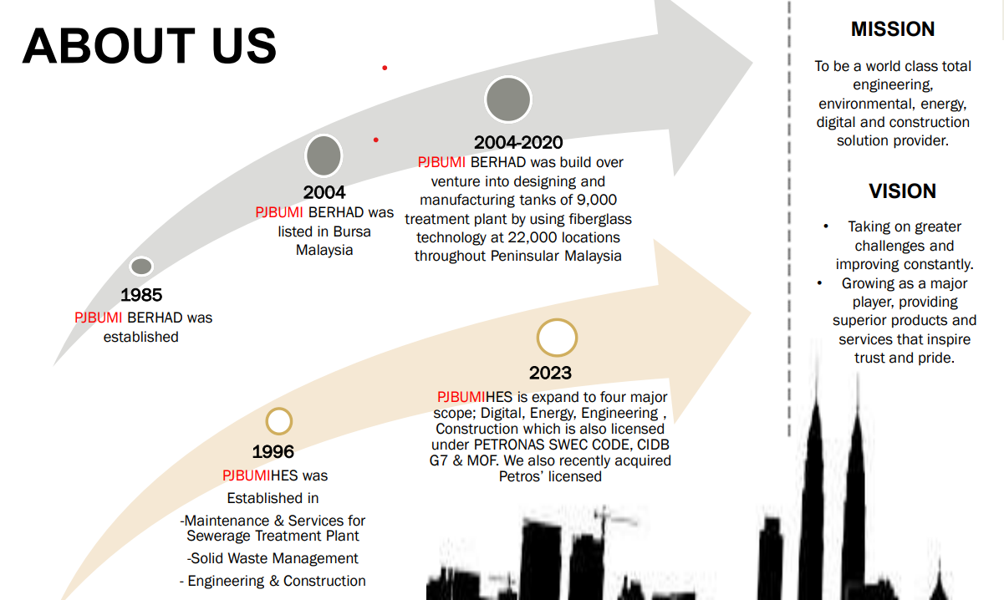

Slide 5
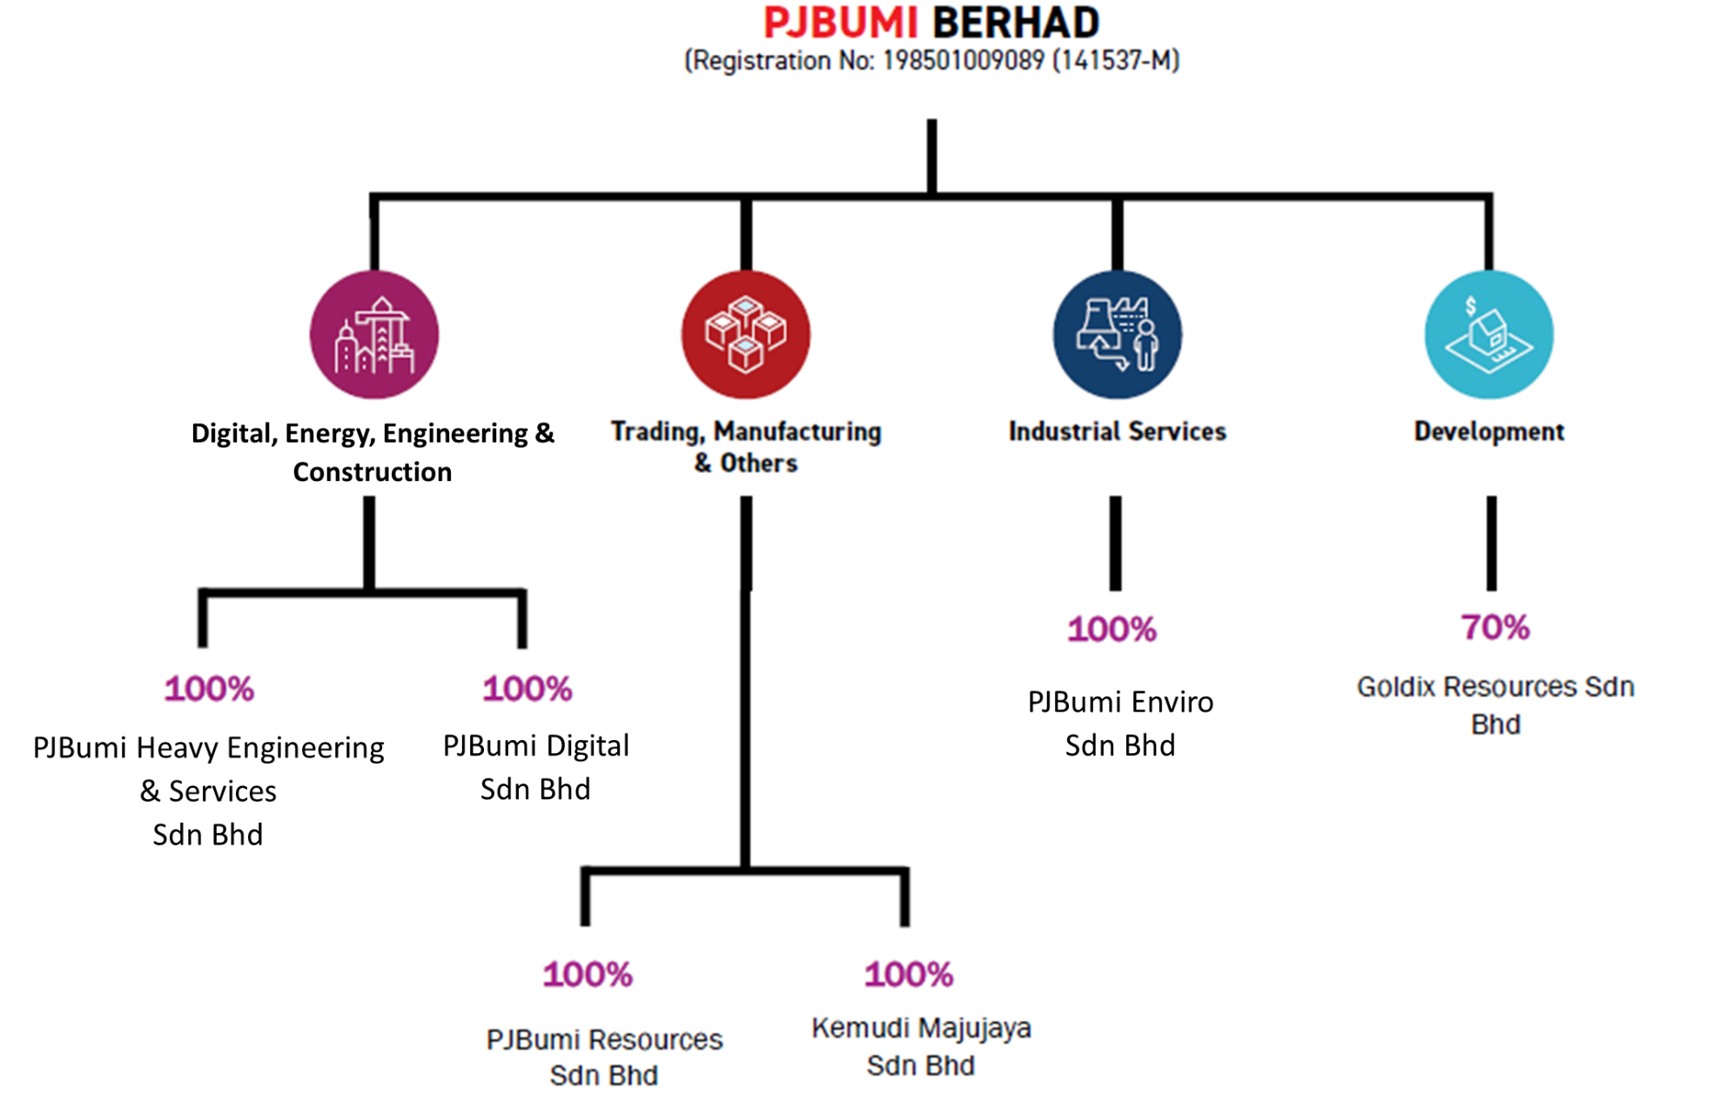
PJBumi Group
(Company Structure)

Slide 6
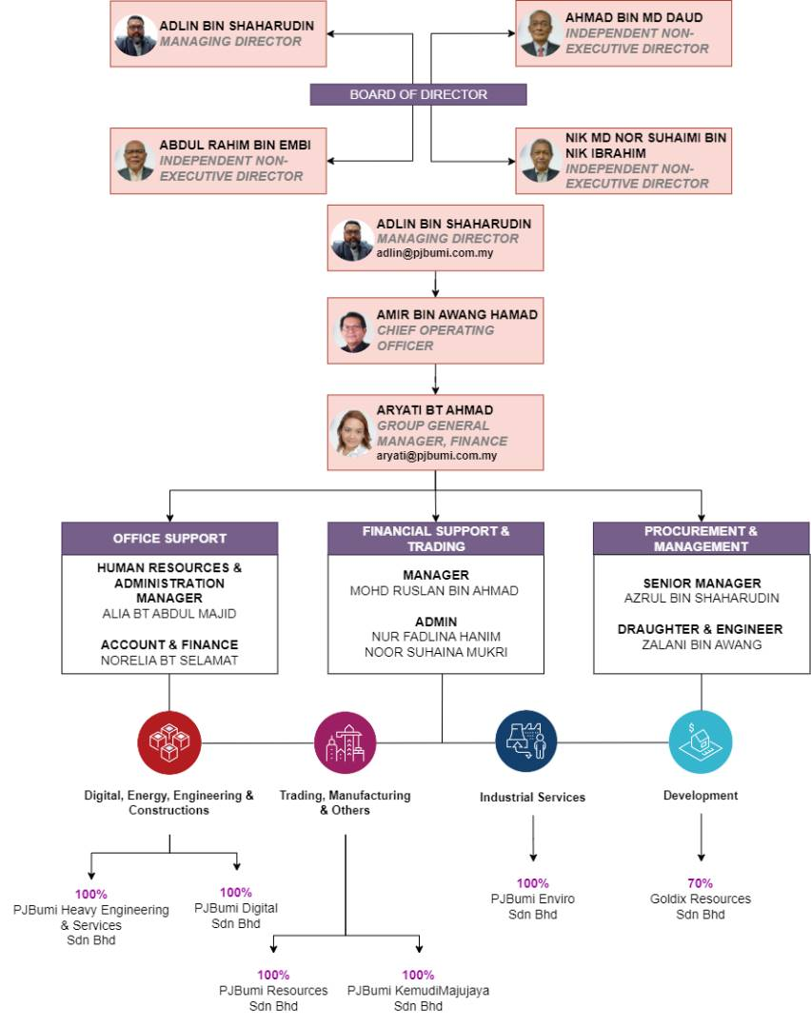
Organizational Chart
PJBumi Bhd

Slide 7
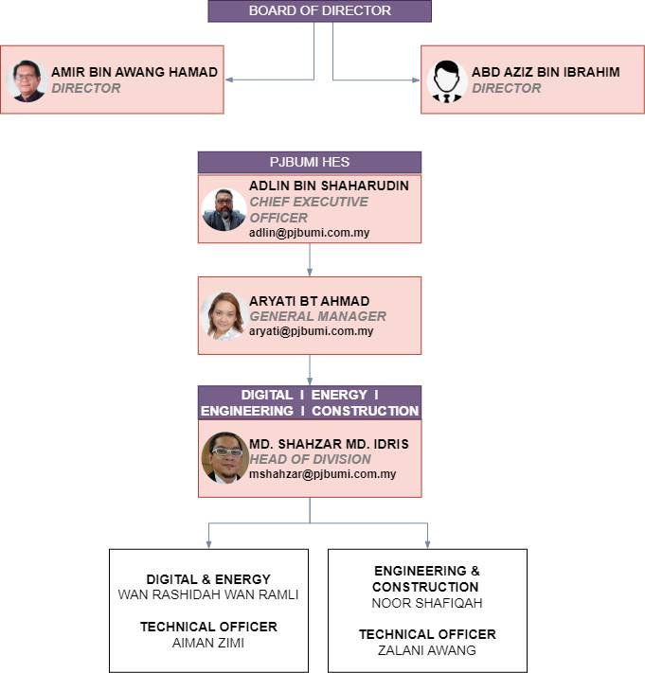
Organizational Chart
PJBumiHES

Slide 8
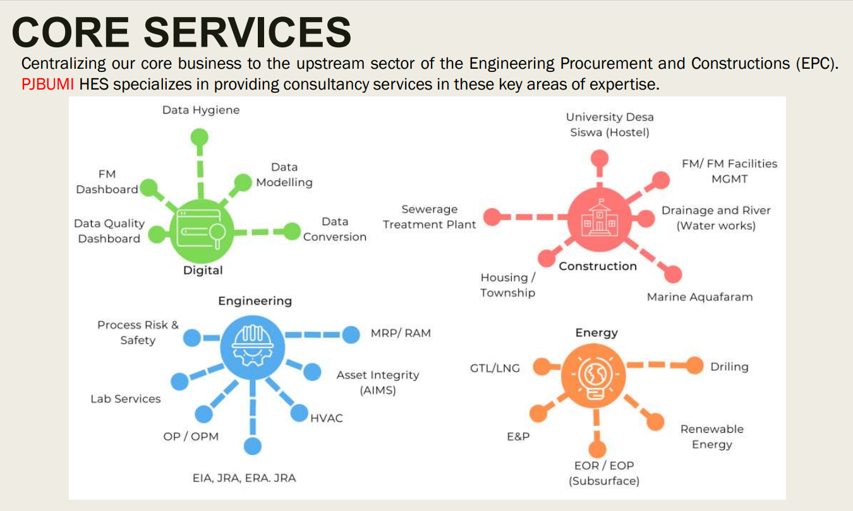

Overall Business Areas 2023
Back to slide 2

Slide 9
Partners and Principals
Digital
Energy
Engineering
Construction
Canopus-GBS (SAP/India)
Fast Track (SAP)
Transmobile / Transfm
Mesiniaga
CETM/AdvanSoft (ECOM Tablet)
Uniq Central (Data Center)
Upstream
CITIC Construction
CRRC Malaysia
AFEX Global Ltd
Downstream
CITIC Construction
CRRC Malaysia
JEREH LNG
CITIC Construction
CRRC Malaysia
Bureau Veritas
UPM i-Aquas (EIA)
Krest Engineering (India)
Ashiatech Engineering
Plant & Power (HVAC)
P. Ranhill Worley
Prisma Laboratory

Slide 10



















Partners and Principals
PJBUMIHES
Subsurface
Environment
EPCC/HVAC
Engineering
Digital
Construction
I-Aquas

Slide 11
DIGITAL SERVICES
PJBUMIHES
Back to slide 2

Slide 12

Digital Focus Areas [DFA]
Engineering Technical Services [ETS]
Digital Services
Digitalization
Data Lake / Data Warehouse
Data Sanitation / Data Hygiene
Data Conversion & Data Modelling
Data Migration
  Hardcopy to Softcopy
  PDF/Native to database
  Legacy system to advanced system
Raw data to interpreted and
analyzed data / Interpreted Information Databank
Back to slide 2

Slide 13

Digital Focus Areas [DFA]
Engineering Technical Services [ETS]
Asset Integrity Management (AIMs)
Risk Based Inspection & Studies
Reliability, Availability & Maintainability
Failure Mode Effect & Cause Analysis
Pipeline Integrity Management
Environmental Impact Assessment (EIA)
Journey Risk Assessment (JRA)
Process Risk & Safety
  FERA, EERA, HAZID / HAZOP / SIL
  BOW TIE, ESSA
  Building Risk Assessment
  Gas Dispersion Study
  Dropped Object Analysis
  Fire Water Demand

Slide 14



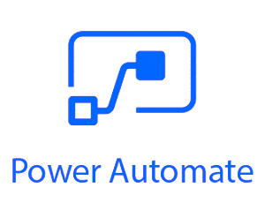

Our Expertise
More than 60 combined man-years of experience in both Digital, Engineering & Technical Services in Energy industry
Experienced SAP Business 1 and MS Power Platforms (Power BI, Power Apps, Power Automate & Power Virtual Agents) environment development and assessments capabilities

Slide 15


PETRONAS PAST PROJECT
PETRONAS ENGINEERING DATA
MANAGEMENT SYSTEM (P-EDMS)
UPSTREAM DATA QUALITY (UDQ) DASHBOARD

Slide 16
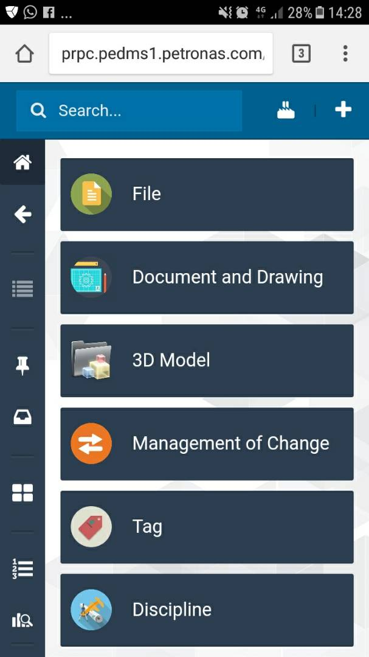
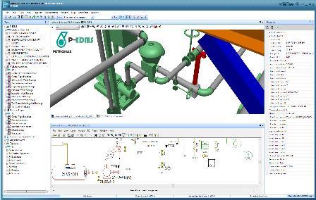
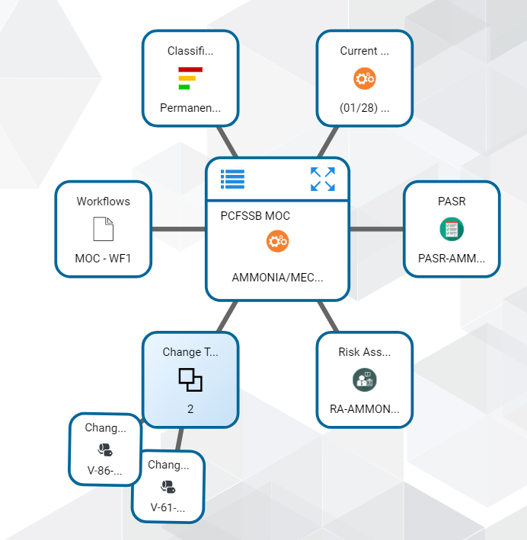
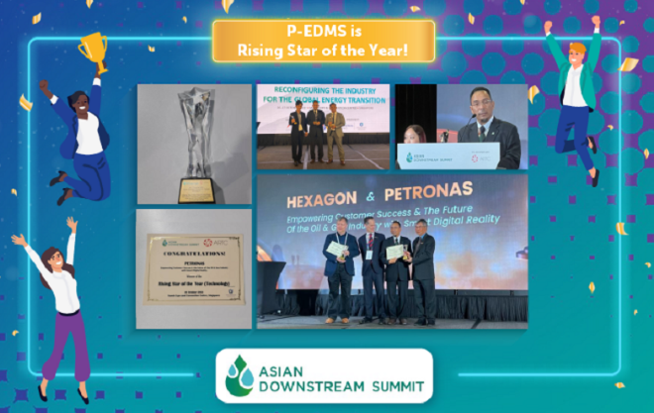
Introduction : P-EDMS
Key Milestone
2008
EDMS initiated through Skill Rationalization (SR) Project under R&T Division
P-EDMS is an electronic and web-based Engineering Database and Management System for Projects and Plant Operations.
P-EDMS provide online access to the following engineering information:
  2D drawings (P&ID, Instrumentation, Electrical, Isometric etc)
  Engineering docs (Datasheets, Line List, etc)
  3D Models viewing online
P-EDMS has engineering workflows capability (EMOC, Engineering Review, Risk Assessment, PASR etc).
2011
P-EDMS Establishment in GTS
2012
MSSA established between PETRONAS and HEXAGON as the OEM
2014
P-EDMS is endorsed by PETRONAS MC as a standardized engineering solution Group wide
2015
PETRONAS Material Reference Coding (PMRC) developed replacing Shell MESC for Piping Class
2017
P-EDMS deployed in over 30 Projects & Operations site (Upstream & Downstream)
2022
Internal

Slide 17
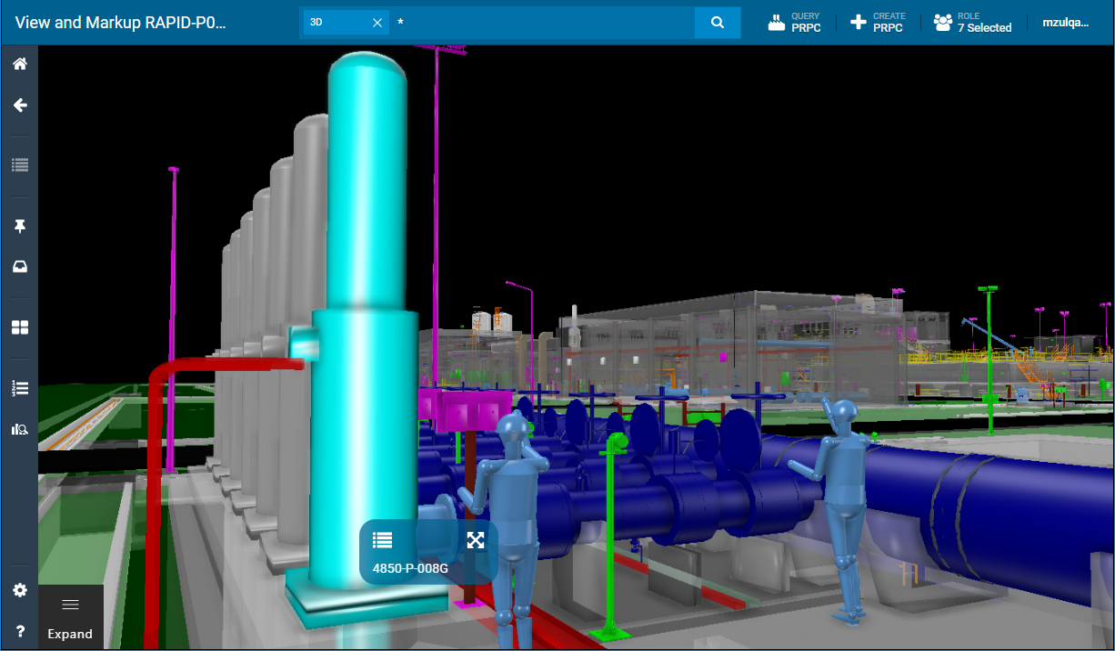
P-EDMS
PETRONAS Engineering Data Management System
P-EDMS manage Engineering Data throughout its lifecycle.
It supports:
Engineering Document Management
Engineering Changes
Engineering 3D/2D View
Integration with other systems
Mobility Access
Web Client
User can login to P-EDMS via web-portal from anywhere with internet connection. Easy to search, navigate, view 3D model without installation
Internal

Slide 18



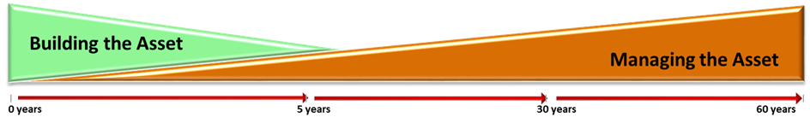
P-EDMS Blueprint
Engineering Design Tools
Completion Tracking System (P-CTS)
Enterprise System
SPPID
O&M Maintenance System
Thickness Measure Location (TML)
3D
Flange Management Tool (FMT)
SPI
O&M Turnaround Mgmt System
Enterprise Service Bus (ESB)
SPEL
CAD
Project & Change
Handover & Validation
O&M Data
SAP & other ERM system
EDW
VDW
FDW
P-EDMS
ENGINEERING DESIGN BASIS – Asset Data / Drawings / Documents / 3D / P&ID / PMRC
Capital Project & Engineering Management
Plant Change Project
Management
Drawing Office Service Request
Work pack Management
Standards
Tools
Visibility
Metrics
Governance
Internal

Slide 19
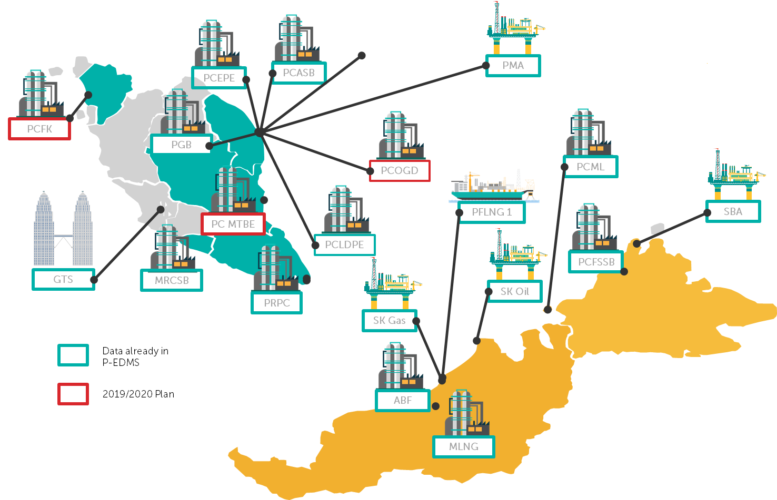
Internal
Notes:
PPTSB

Slide 20
P-EDMS PRESENCE ACROSS THE GLOBE
Netherlands & Germany
Canada
UK & France
Spain & Italy
China
UAE & Iraq
Japan &
South Korea
Thailand
Malaysia &
Singapore
> 17 countries
32 active projects
> 60 SPO Instances
15 OPUs / HCUs
>30 Contractors
33 Servers
7680 Named Users

Slide 21

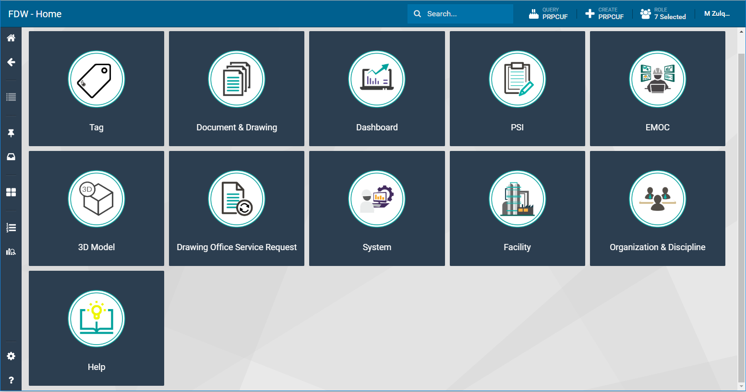


P-EDMS
Key Features of P-EDMS Web Client
Document Management
3D Model Visualization
3D
Navigate and review detailed 3D model of Assets
Search, View, Markup documents, Rev control
Tag Management
Dashboard & Reports
Register, consistency check
Automated dashboard generation & reporting
Integrated System
Workflow Engine
Connection to ERP & O&M system
Fully configurable workflow with distribution matrix
Zero foot-print
Access & browsing thru web browser with no installation needed.
Internal

Slide 22

Document Management
Manage document throughout its life cycle
01
02
03
04
05
Document Management
Utilize P-EDMS to manage revision cycle, submission from 3rd party or internal to ensure its adhering to PTS standards and PIC policies.
Online Doc Review
Document Numbering
Document Workflow
Document Revision
Web Submission
Internal

Slide 23
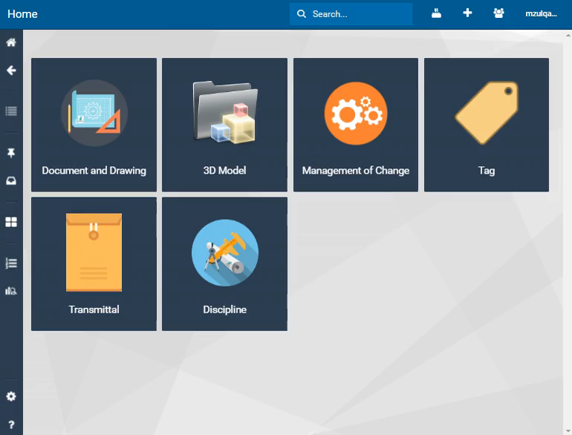
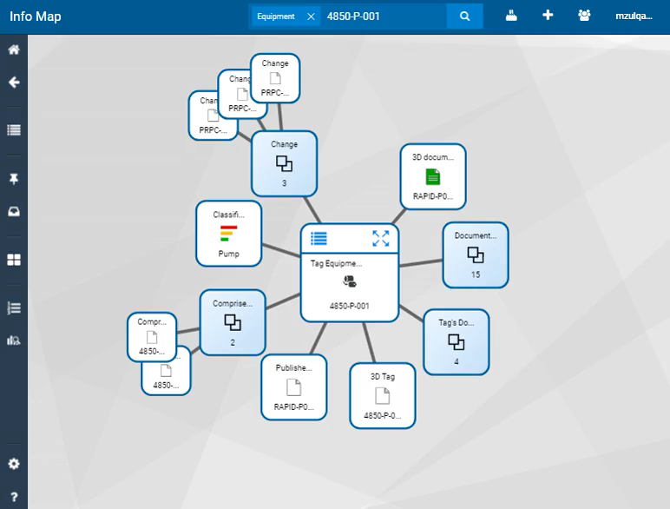
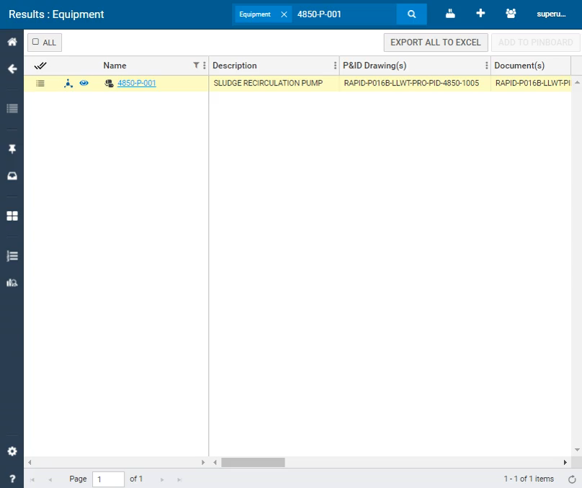
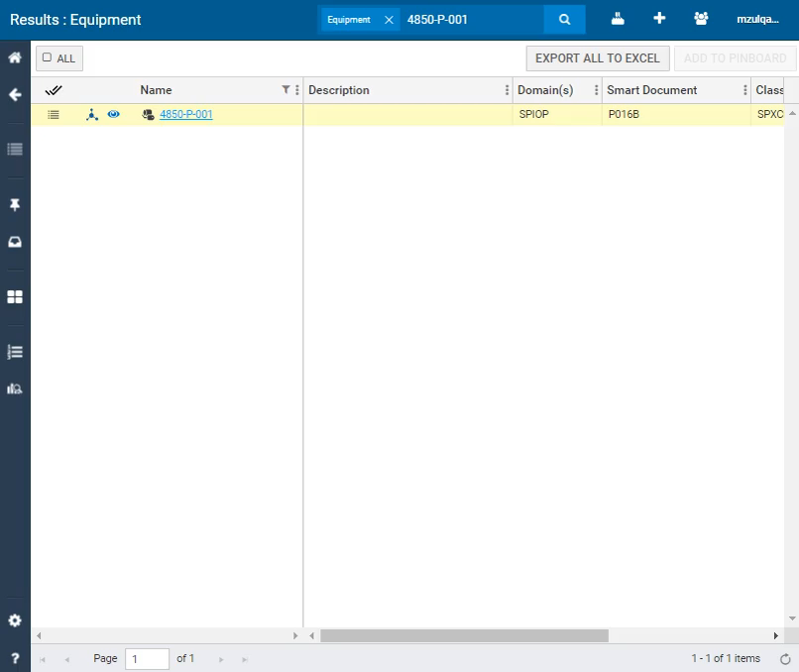
Navigate & View
Access to 2D – 3D thru web browser
Tag
Document
Smart Doc
3D Model
You can simply search by Tag number and see all relationship.
Ease of access to documents
(Search, view, download).
Hotspotting equipments drafted, view engineering design data.
Zoom in selected tag, navigate around the facilities, access to Eng data.
Internal

Slide 24
Navigate and View
Access to 2D – 3D thru web browser
Tag Management
Register, consistency check
You can simply search by Tag number and see all relationship.

Slide 25
Navigate and View
Access to 2D – 3D thru web browser
Document Management
Search, View, Markup documents, Rev control
Ease of access to documents
(Search, view, download).
.

Slide 26
Navigate and View
Access to 2D – 3D thru web browser
Smart Document
Connection to ERP & O&M system
Zoom in selected tag, navigate around the facilities, access to Eng data.

Slide 27
Navigate and View
Access to 2D – 3D thru web browser
3D Model Visualization
Navigate and review detailed 3D model of Assets
3D
Hotspotting equipments drafted, view engineering design data.

Slide 28
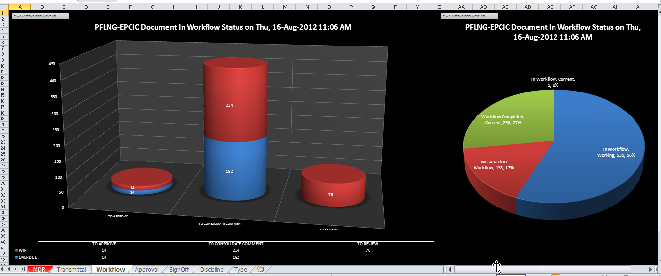
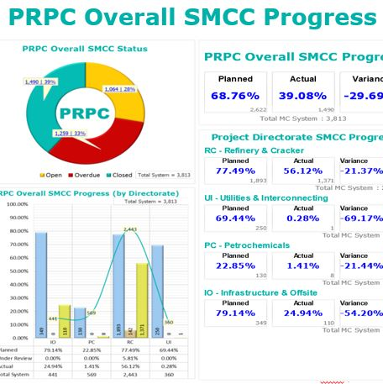
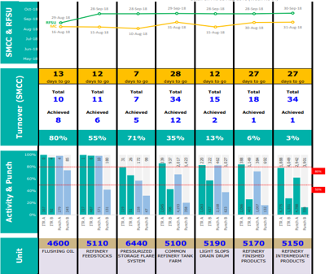
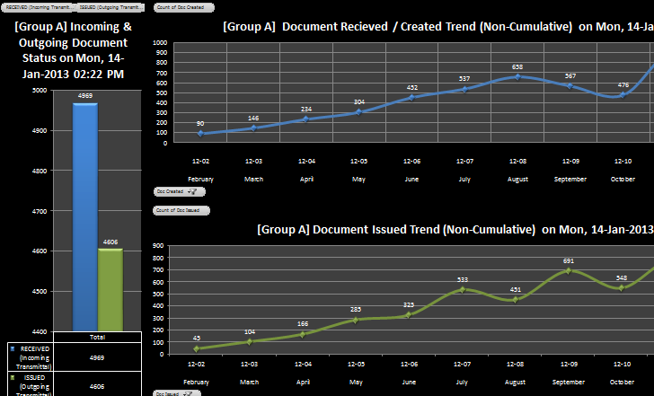
Reports &
Dashboards
Get a modern reports and dashboard on Document Management statuses. Easy to track and report KPIs, status for all type of reporting to different level of consumers.
Internal

Slide 29
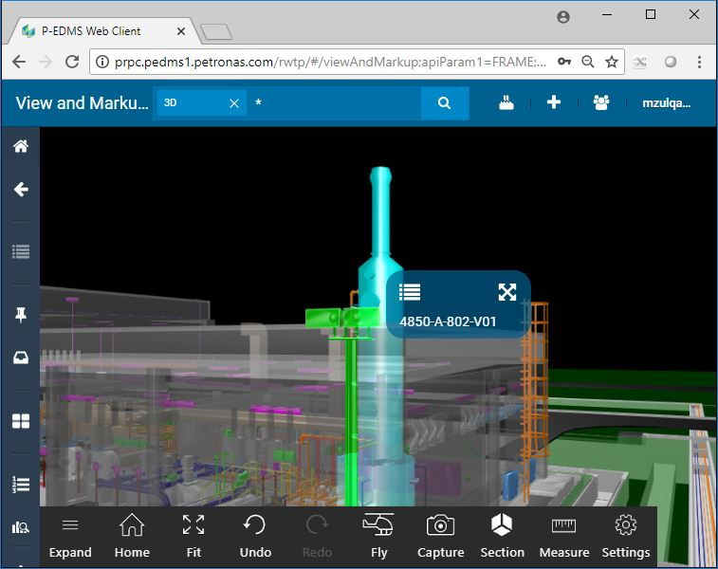
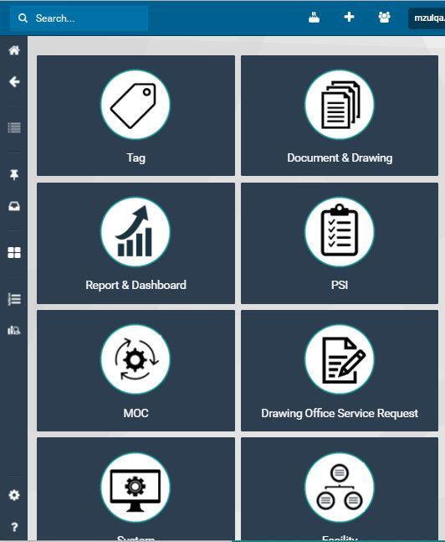

Mobile Access
No installation required. Zero foot-print
P-EDMS on Mobile
Access thru pervasive Wi-Fi
You can access to documents and drawings as well as 3D via Tablet connected to Wi-Fi.
Access thru Internet
Gain access to your references anywhere internet are available. Login with your PETRONAS credential.
View Documents
Online Comment
3D model access
Easy to change colors, photos and Text.
Easy to change colors, photos and Text.
Easy to change colors, photos and Text.
Internal

Slide 30
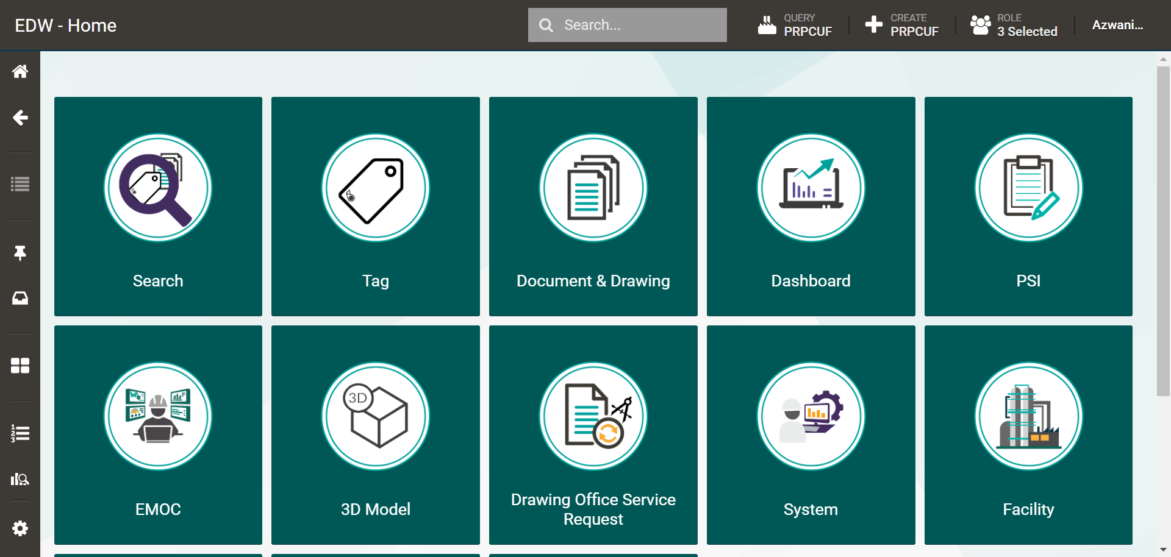
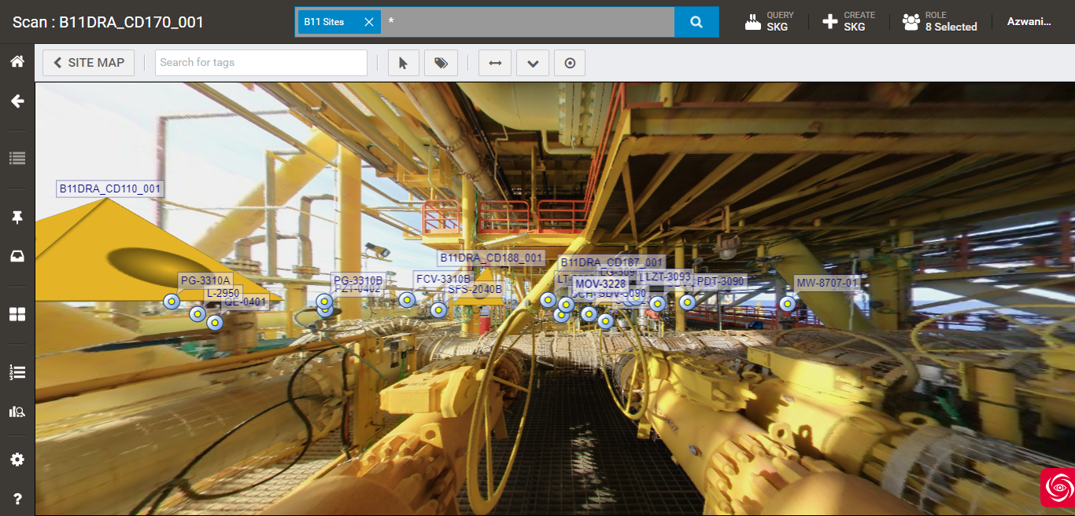
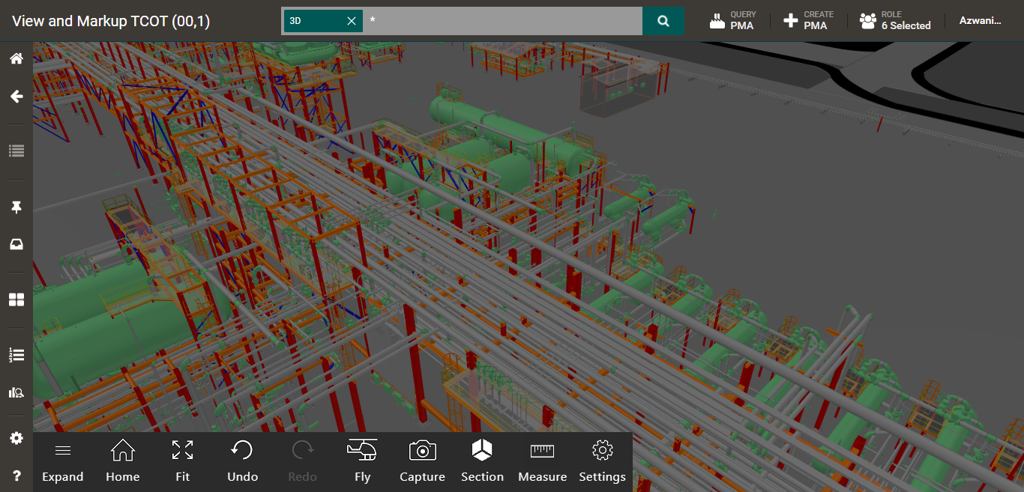
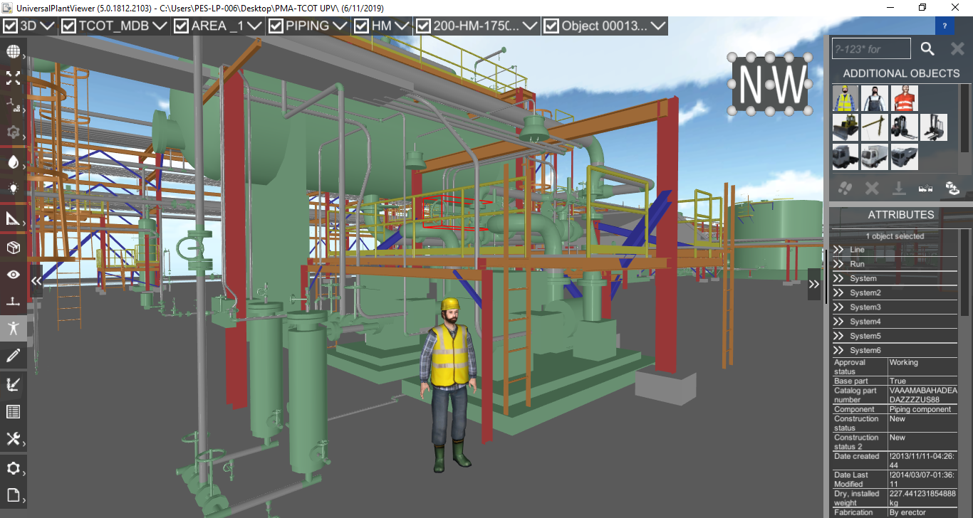
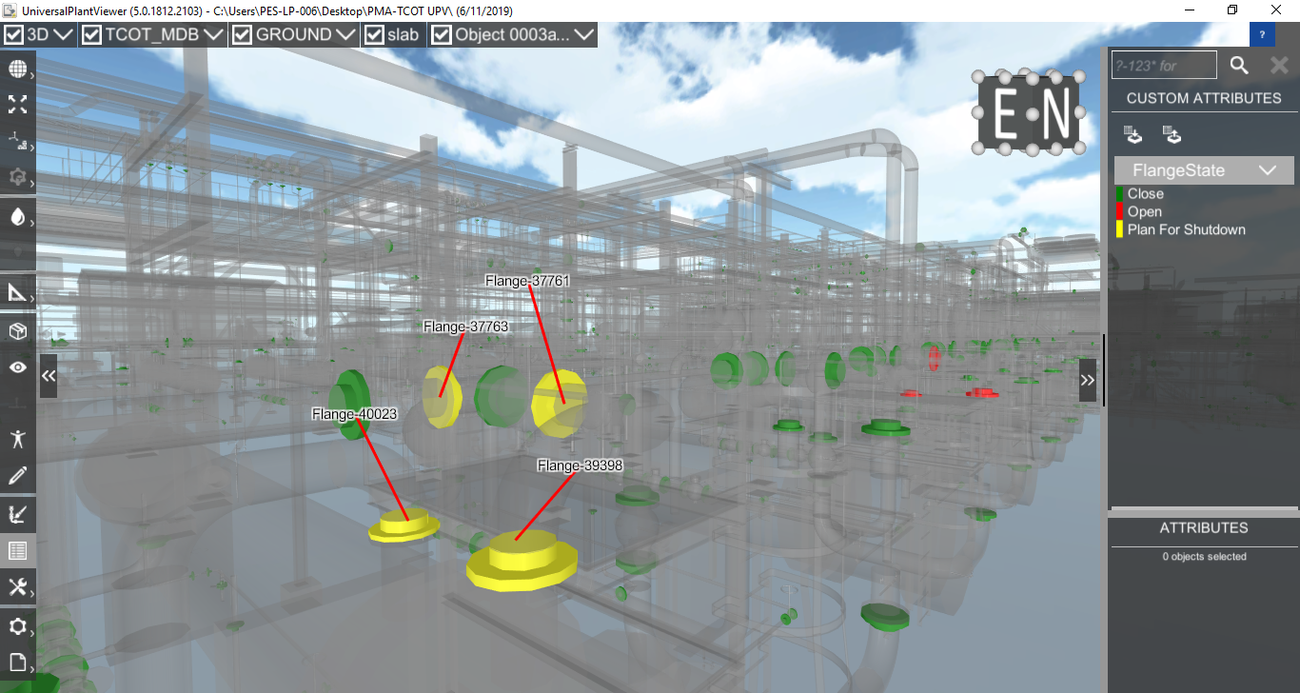
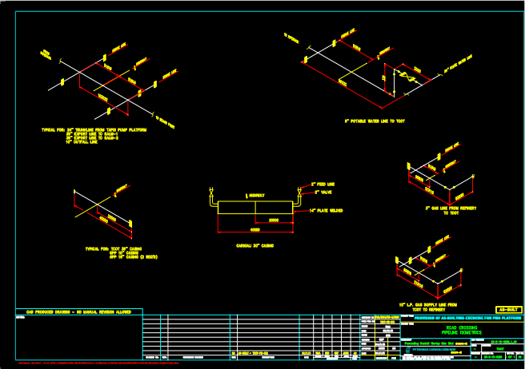
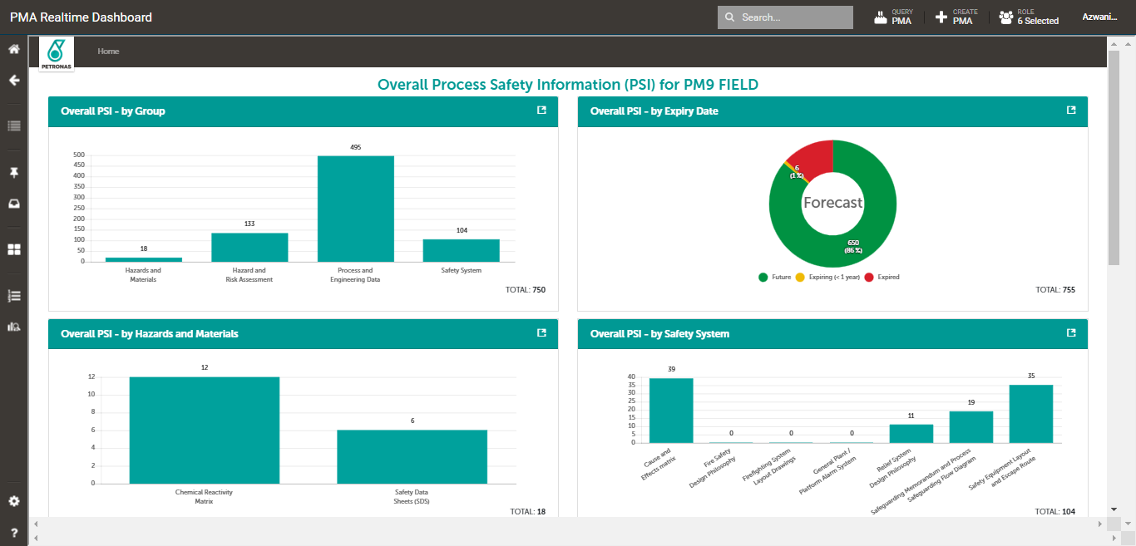
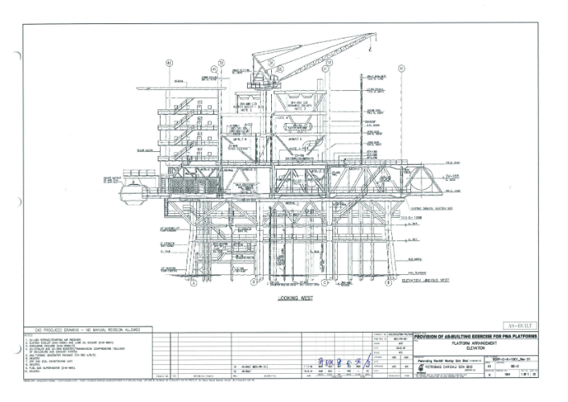
USER APPLICATION OF 3D IN P-EDMS
Internal

Slide 31

Value Creation
P-EDMS managing effective and efficient engineering data
Paperless final documents handover from Projects to Operations.
Cost avoidance to MLNG Train 9 Project = RM 750K
Quick access to latest engineering information
Back to Slide 13
Internal

Slide 32
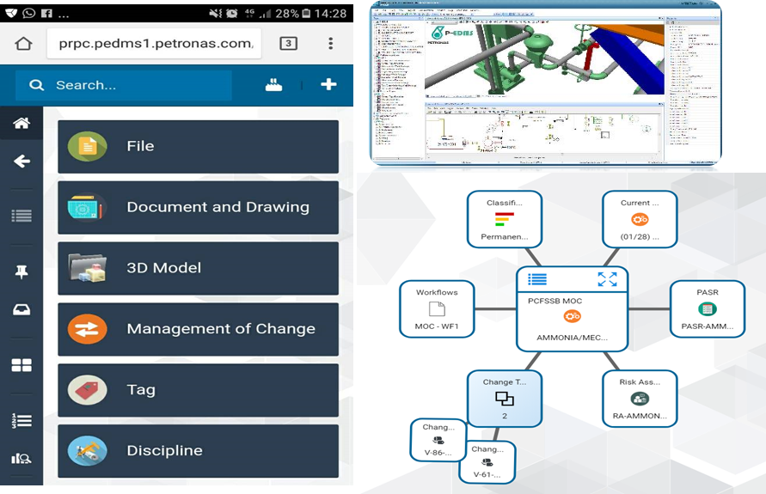
PETRONAS PAST PROJECT
P-EDMS is an electronic and web-based Engineering Database and Management System for Projects and Plant Operations.
P-EDMS provide online access to the following engineering information:
  2D drawings (P&ID, Instrumentation, Electrical, Isometric etc)
  Engineering docs (Datasheets, Line List, etc)
  3D Models viewing online
P-EDMS has engineering workflows capability (EMOC, Engineering Review, Risk Assessment, PASR etc).
PETRONAS ENGINEERING DATA
MANAGEMENT SYSTEM (P-EDMS)

Slide 33
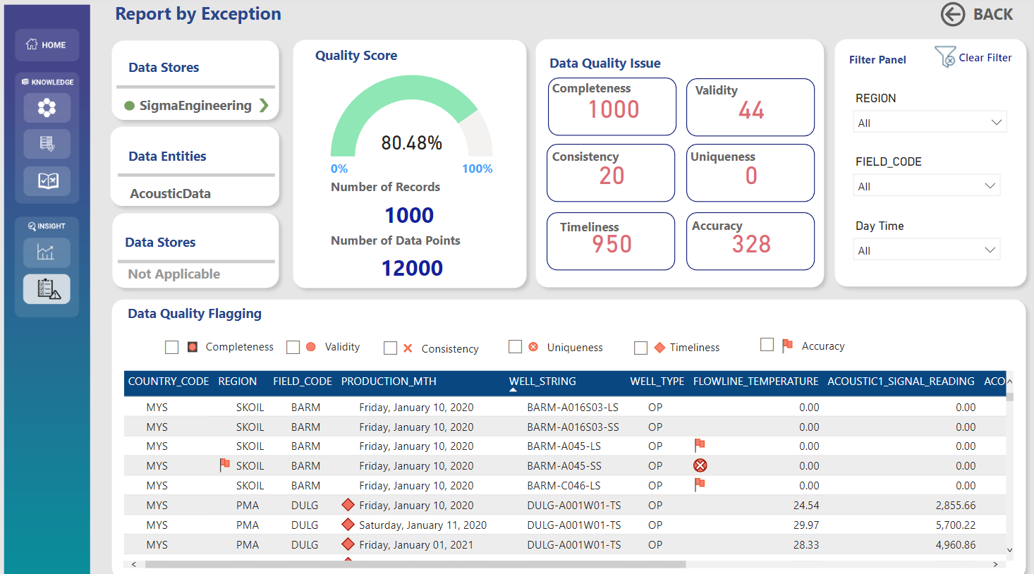
PETRONAS PAST PROJECT
Back to slide 2
Data Quality Score
6 Data Quality Dimensions
PJBUMI Engineering
Filter Panel
Dashboard Navigation
Data Flagging
UPSTREAM DATA QUALITY (UDQ) DASHBOARD

Slide 34
ENVIRONMENTAL SERVICES
PJBUMIHES
Back to slide 2

Slide 35
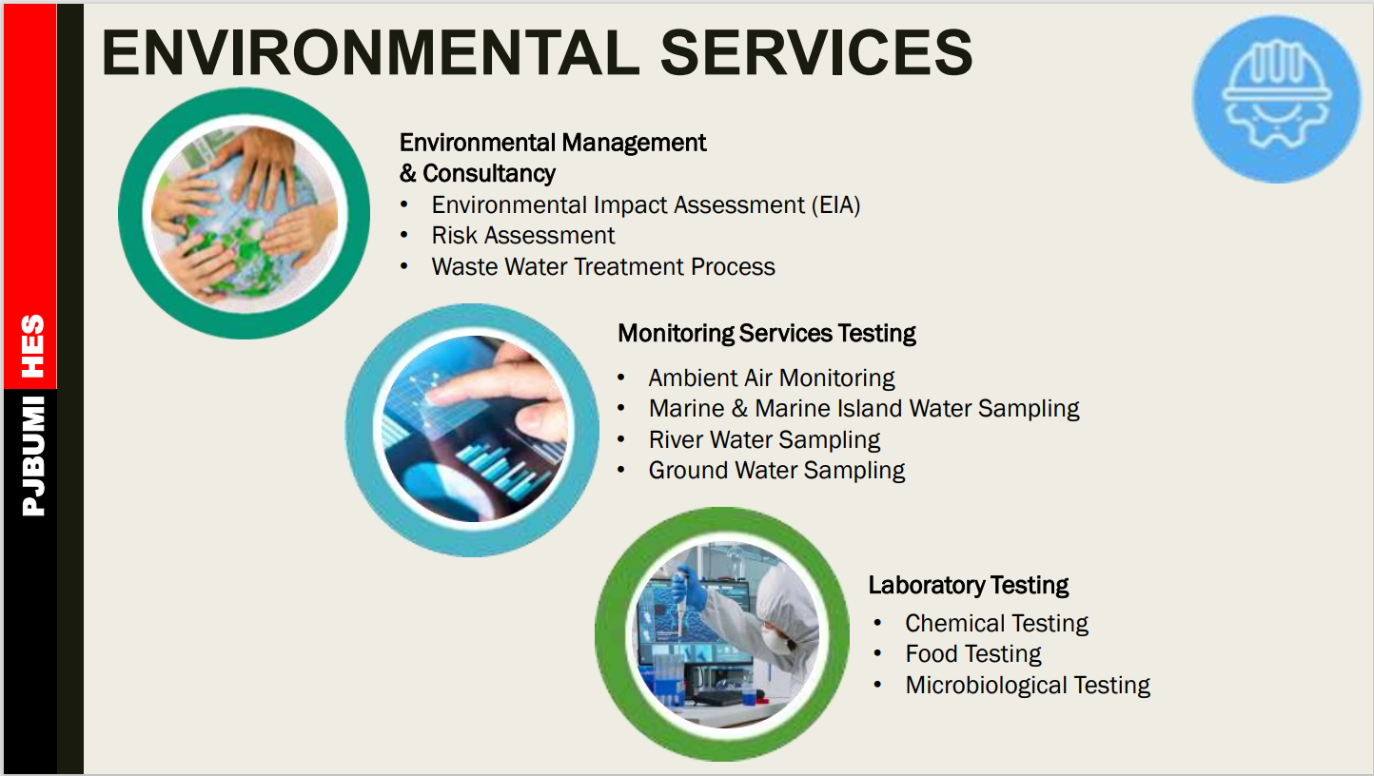
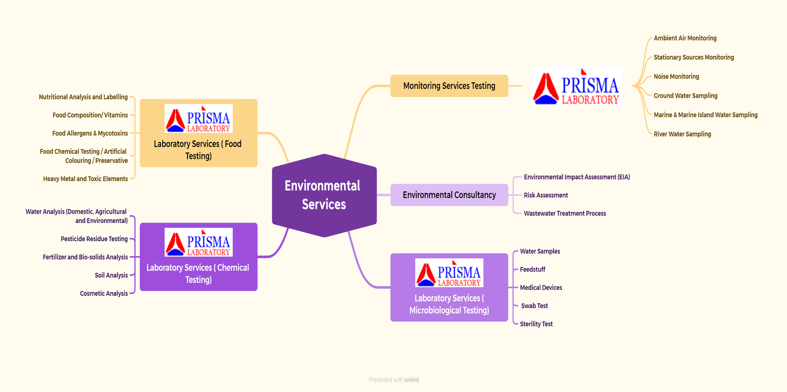
ENVIRONMENTAL SERVICES
Back to slide 2

Slide 36
LICENSES & TRACK RECORDS
PJBUMIHES

Slide 37
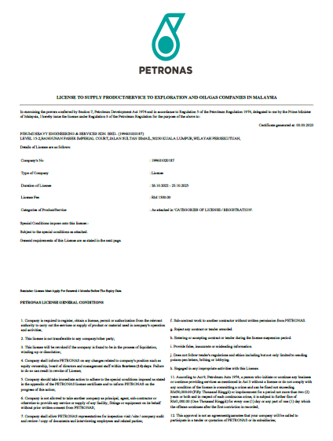
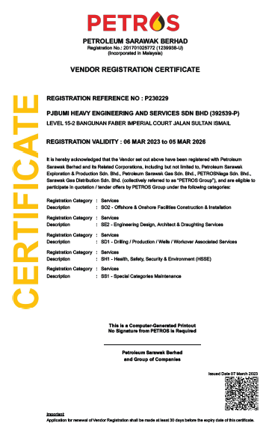

License & Registrations
PETRONAS
PETROS
Back to slide 2

Slide 38

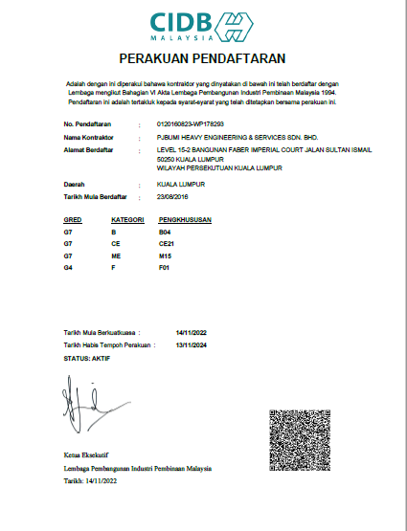
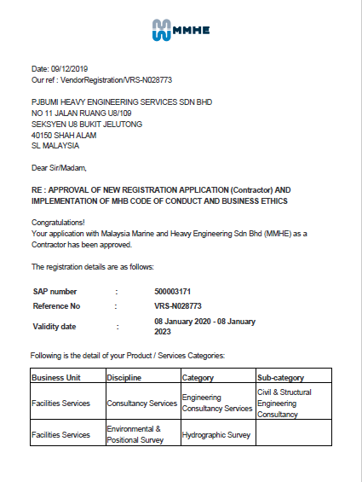


License & Registrations
CIDB G7 & G4 (F01)
MMHE

Slide 39
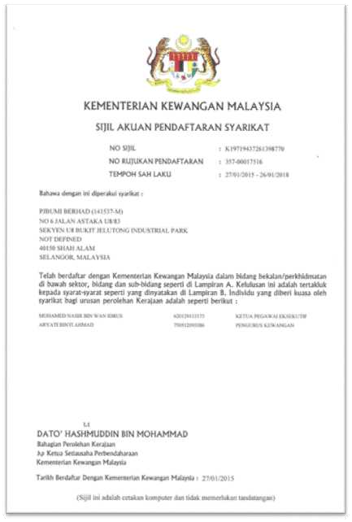
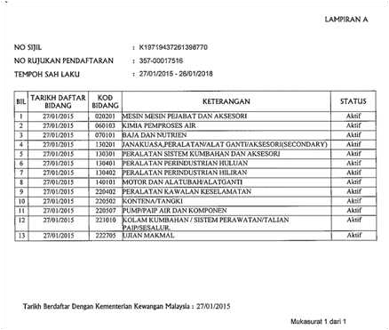
Licenses
www.pjbumi.com.my

Slide 40
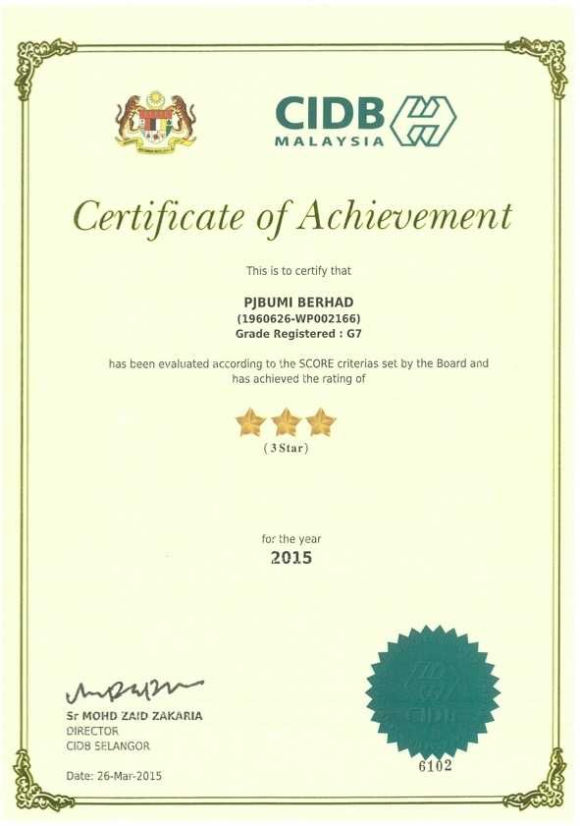
Licenses
www.pjbumi.com.my

Slide 41
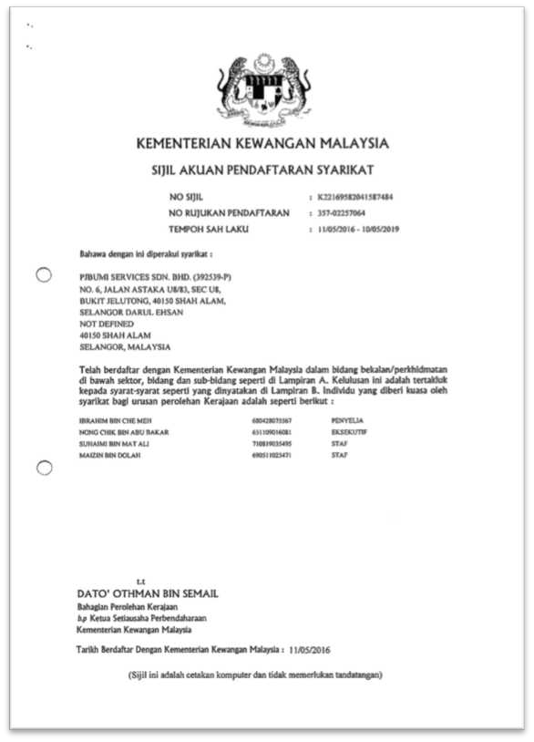
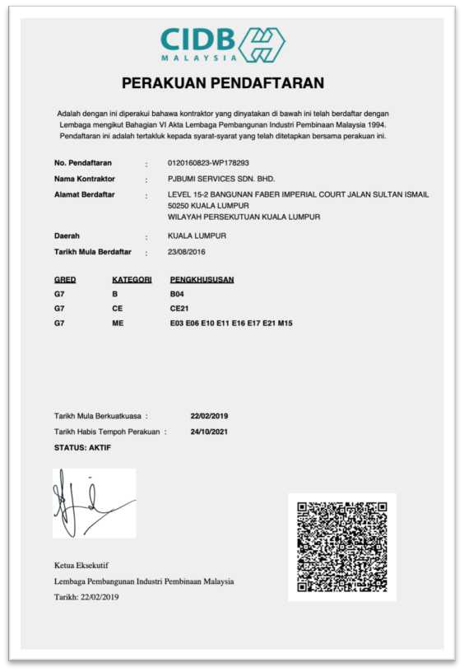
Licenses
www.pjbumi.com.my

Slide 42
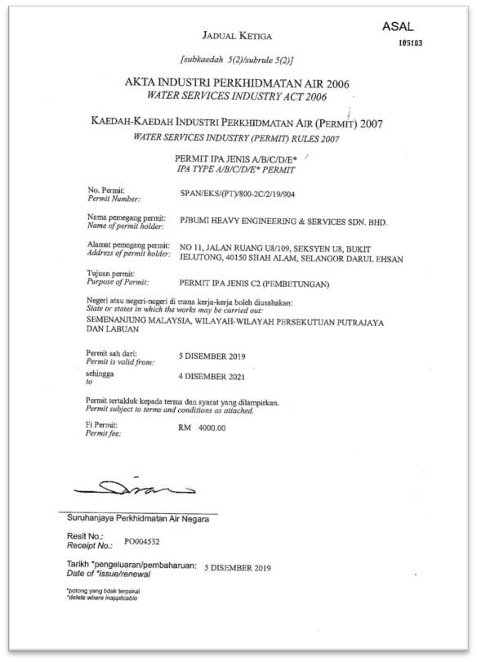
Licenses
www.pjbumi.com.my
Back to slide 2

Slide 43
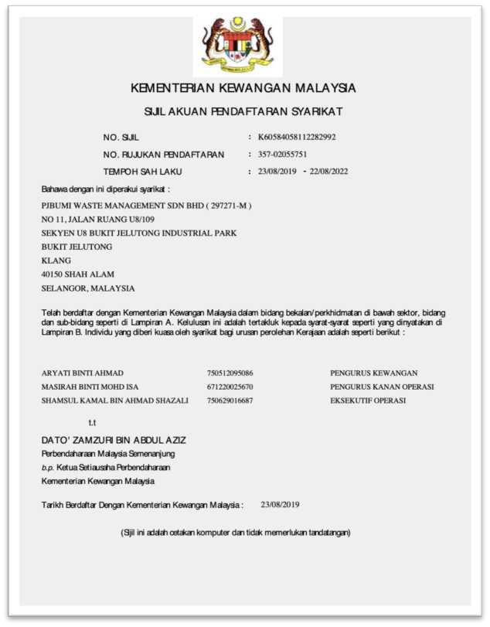
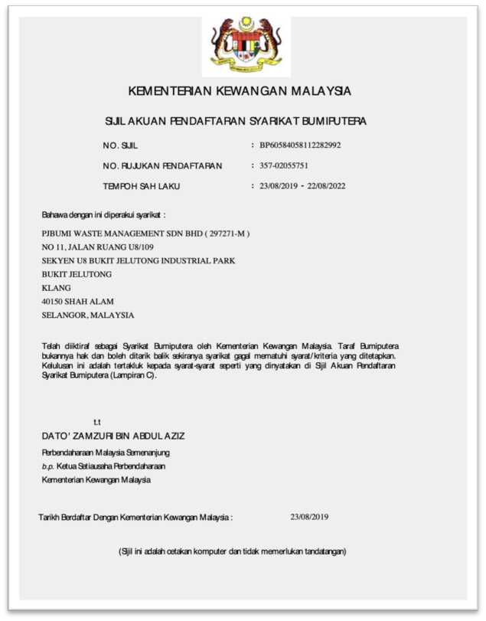
Licenses
www.pjbumi.com.my

Slide 44
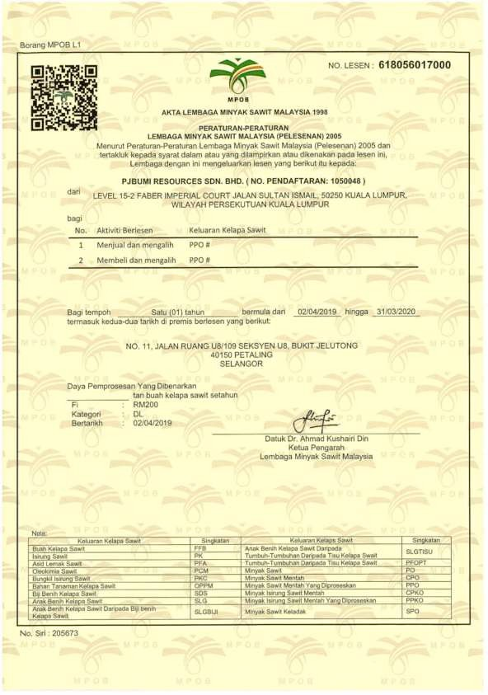
Licenses
www.pjbumi.com.my

Slide 45


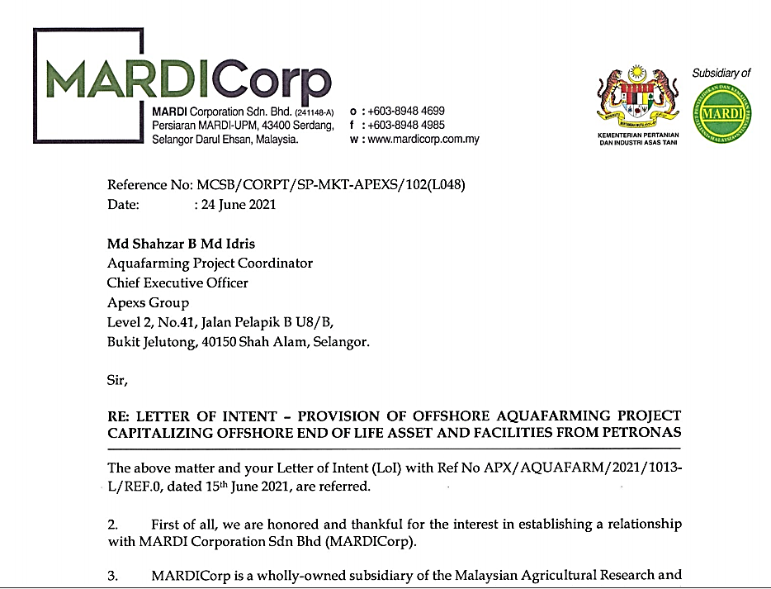


PAST EXPERIENCES | TRACK RECORDS
ENGINEERING PROJECT MANAGEMENT
|> OFFSHORE AQUAFARM |> INTEGRITY OFFSHORE
TSR NAVAL PLATFORM
Back to slide 2

Slide 46


PAST EXPERIENCES | TRACK RECORDS
ENGINEERING PROJECT MANAGEMENT
|> OFFSHORE AQUAFARM |> INTEGRITY OFFSHORE
TSR NAVAL PLATFORM
PJBUMIHES – Offshore Aquafarming
Project Development Technical Services
for Mardi Corporation Sdn Bhd
PJBUMIHES – Offshore NAVY Platform
Project Development Technical Services
for Kementerian Pertahanan

Slide 47

Oil & Gas Project List - Highlights
Back to slide 2

Slide 48
THANK YOU FOR YOUR PASSION
Moving Forward to Progress Together…

